Slide 1
Inferring Causality with Observational Data (aka arguing about regressions)
Matt Goldman

Slide 2
Prediction
Make a forecast, leaving the world as it is
vs.
Causation
Anticipate what will happen when you make a change in the world

Slide 3
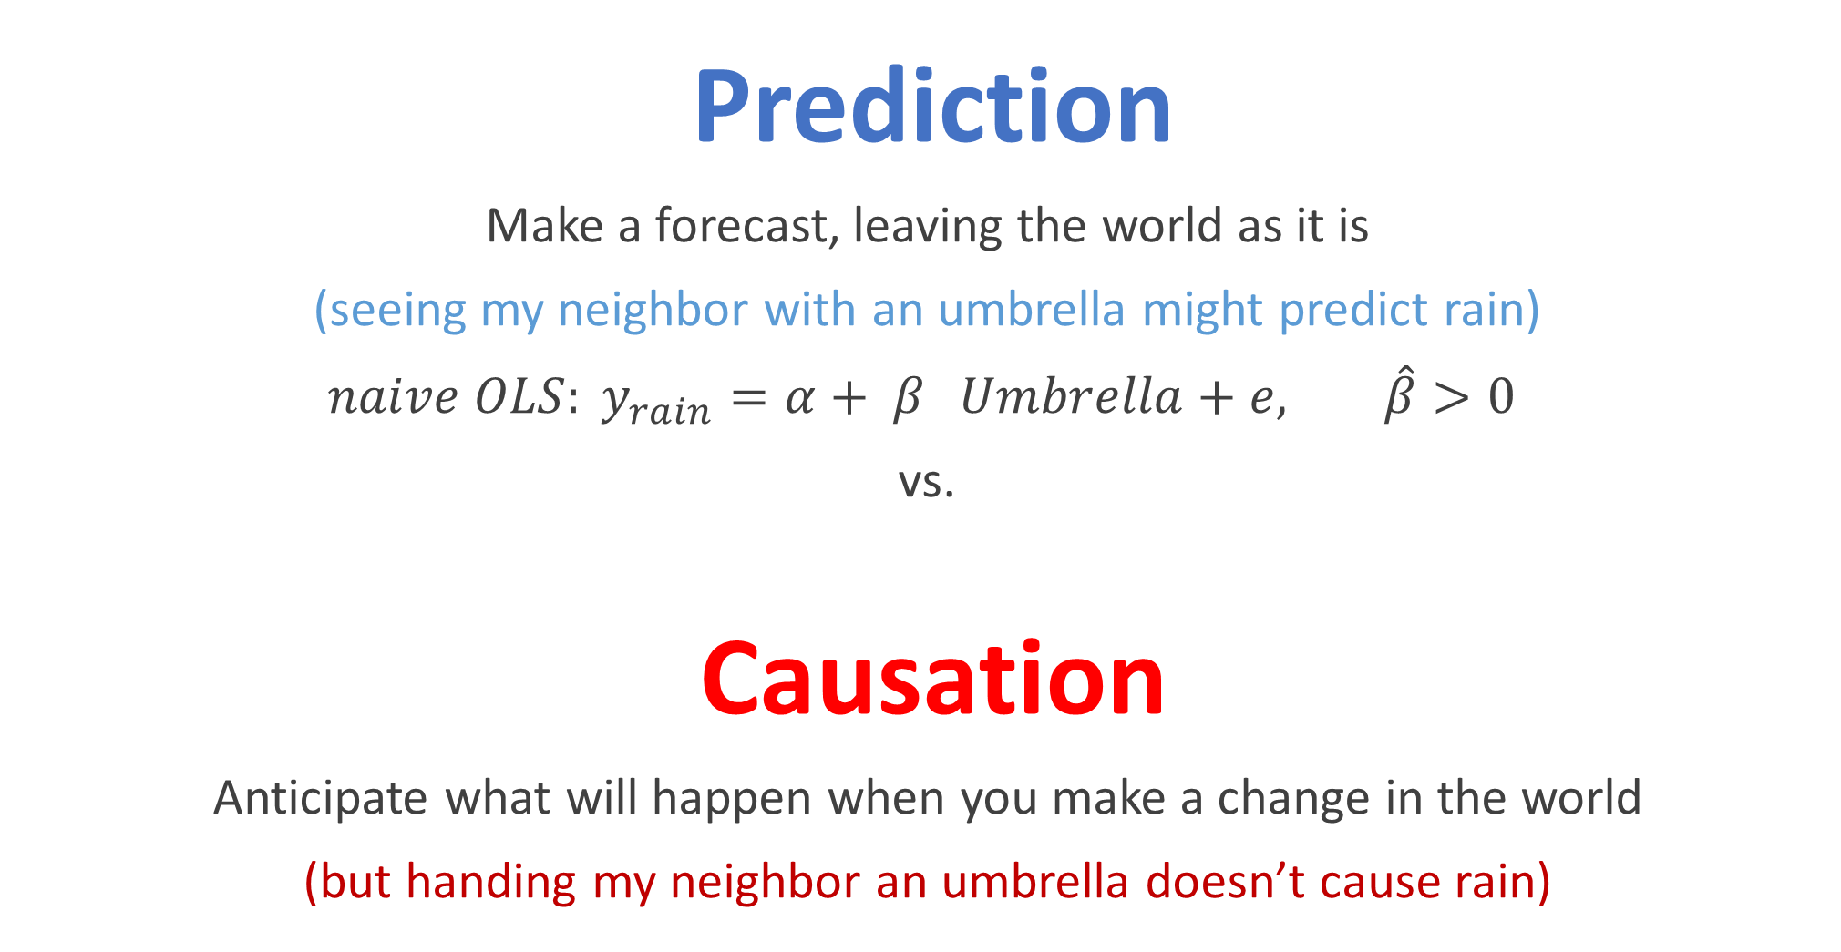
Prediction
Make a forecast, leaving the world as it is
(seeing my neighbor with an umbrella might predict rain)
$naive OLS: y_{rain}=α+ β_{}Umbrella+e, \hat{β}>0$
vs.
Causation
Anticipate what will happen when you make a change in the world
(but handing my neighbor an umbrella doesn’t cause rain)

Slide 4
This is an especially big problem when doing policy analysis. Why?
Policy is often chosen because of concerns about the exact outcome we are measuring.

Slide 5
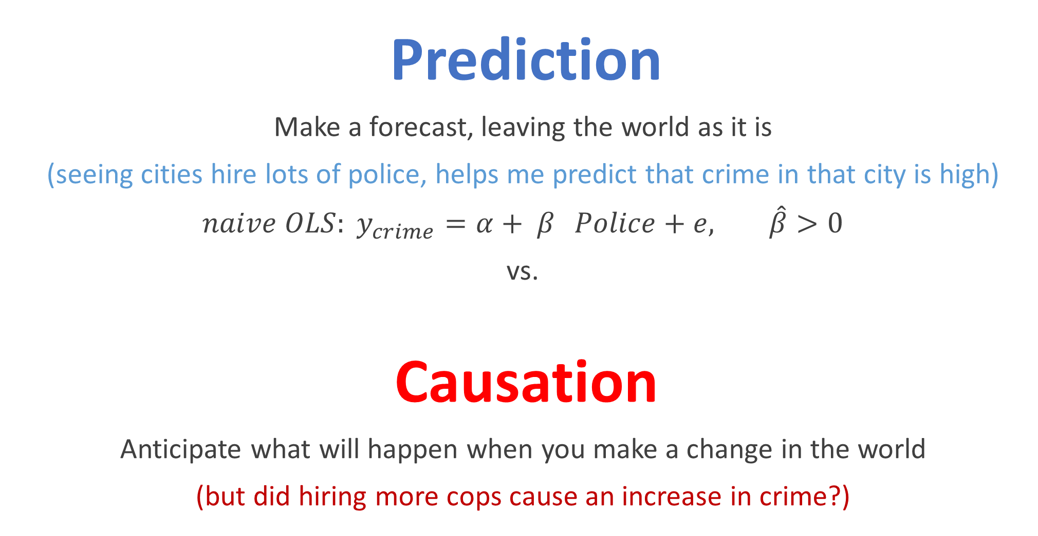
Prediction
Make a forecast, leaving the world as it is
(seeing cities hire lots of police, helps me predict that crime in that city is high)
${naive OLS: y}_{crime}=α+ β_{}Police+e, \hat{β}>0$
vs.
Causation
Anticipate what will happen when you make a change in the world
(but did hiring more cops cause an increase in crime?)

Slide 6
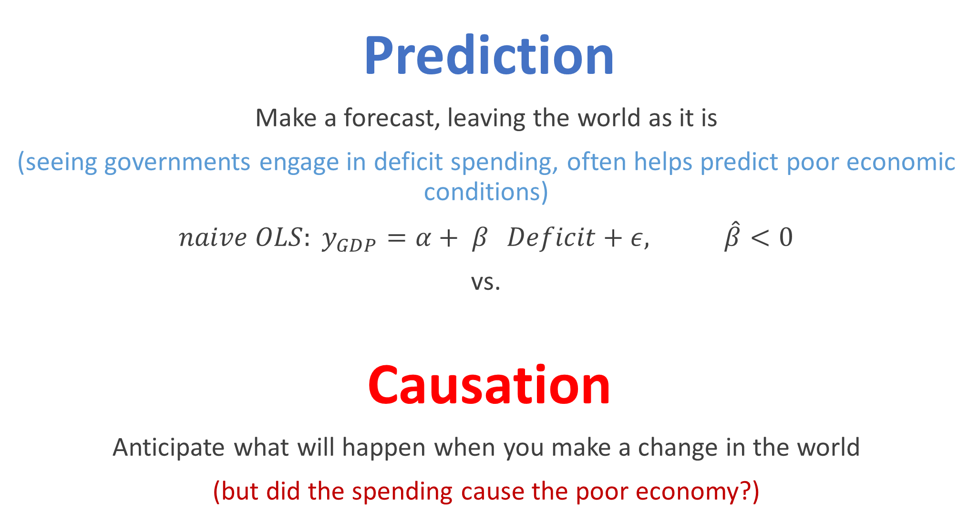
Prediction
Make a forecast, leaving the world as it is
(seeing governments engage in deficit spending, often helps predict poor economic conditions)
${naive OLS: y}_{GDP}=α+ β_{}Deficit+ε, \hat{β}<0$
vs.
Causation
Anticipate what will happen when you make a change in the world
(but did the spending cause the poor economy?)

Slide 7
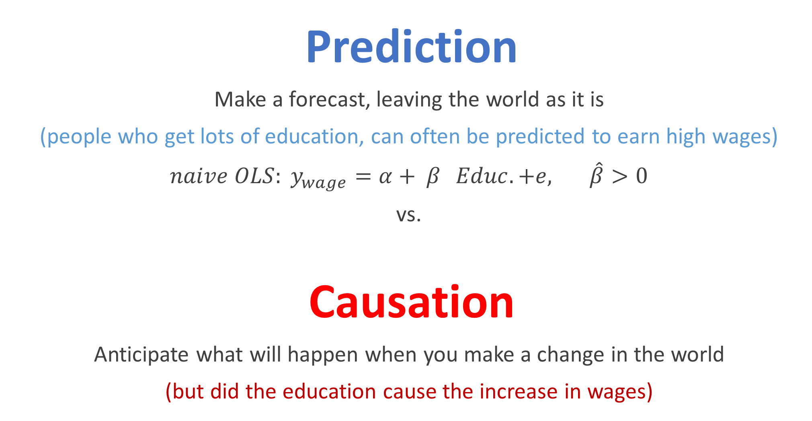
Prediction
Make a forecast, leaving the world as it is
(people who get lots of education, can often be predicted to earn high wages)
${naive OLS: y}_{wage}=α+ β_{}Educ.+e, \hat{β}>0$
vs.
Causation
Anticipate what will happen when you make a change in the world
(but did the education cause the increase in wages)

Slide 8
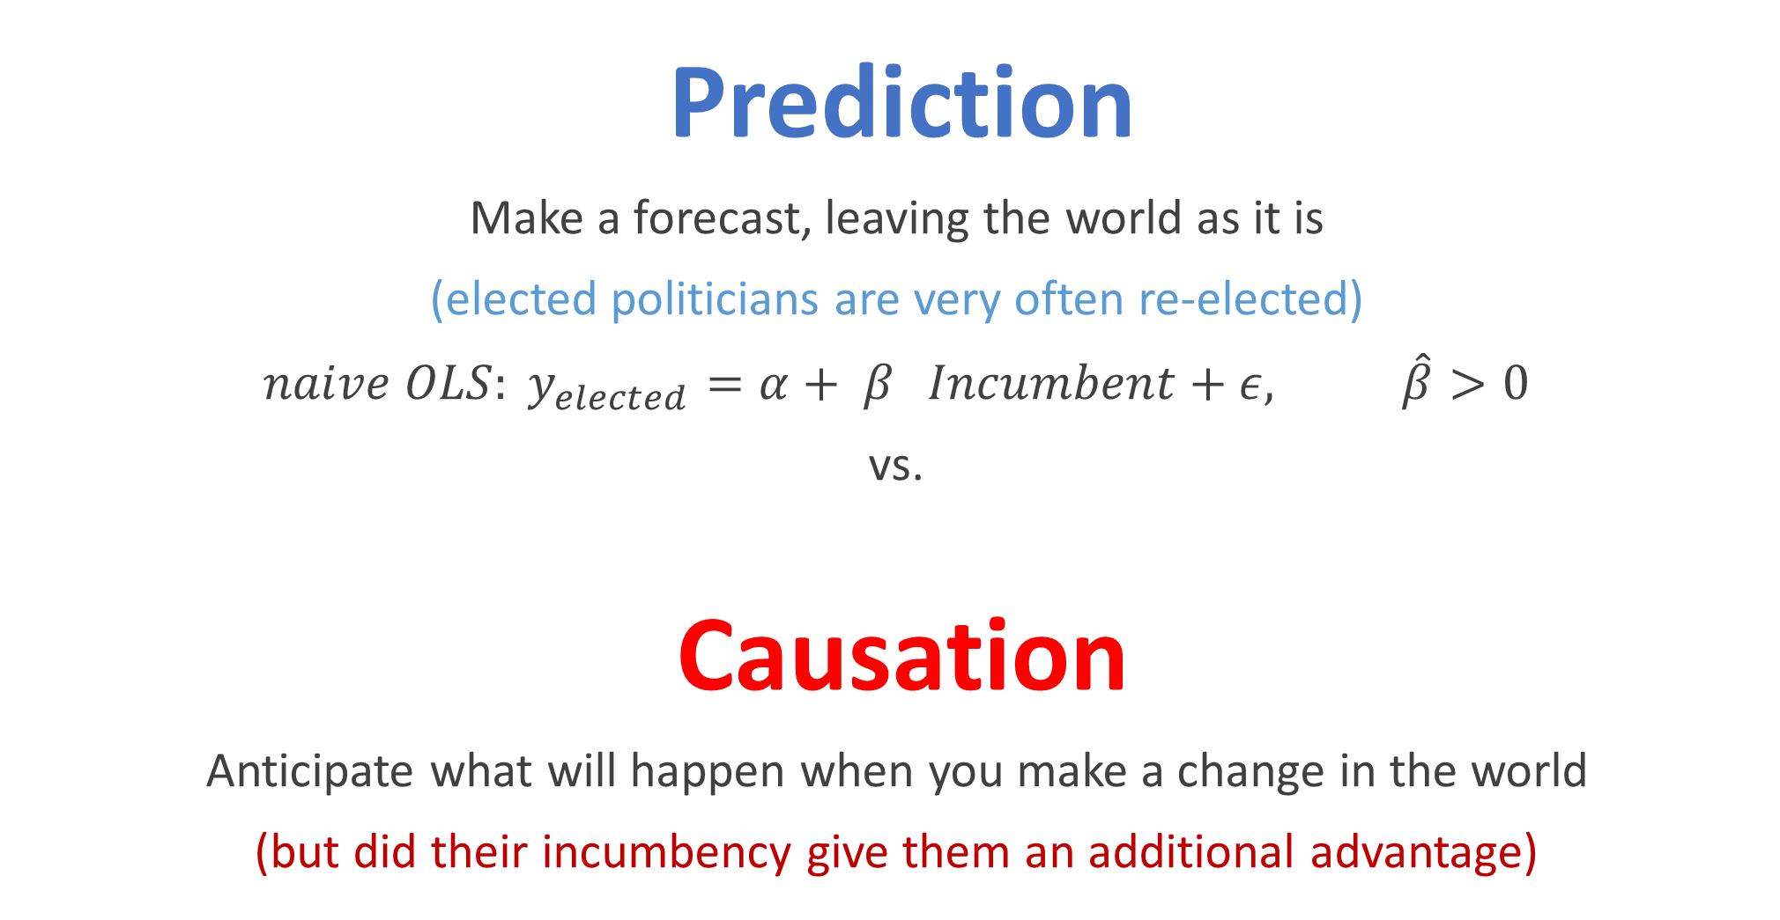
Prediction
Make a forecast, leaving the world as it is
(elected politicians are very often re-elected)
${naive OLS: y}_{elected}=α+ β_{}Incumbent+ε, \hat{β}>0$
vs.
Causation
Anticipate what will happen when you make a change in the world
(but did their incumbency give them an additional advantage)

Slide 9
Measuring Causality: Two Strategies
Run an experiment:
Experimentation is always the gold standard of causal inference.
Getting cities/states/countries/firms to randomize policy is often hard.
Find a natural experiment:
Finding “experiment like” variation in a treatment of interest.
Economists call this: finding a natural experiment.

Slide 10
Do I have a Natural Experiment?
Natural experiments occur when variation in your treatment is independent of any other shocks that impact your outcome.
Typically, you can not test for this criteria in your data. You have to combine critical thinking with intuition about the setting of your study to decide if you have a natural experiment.

Slide 11
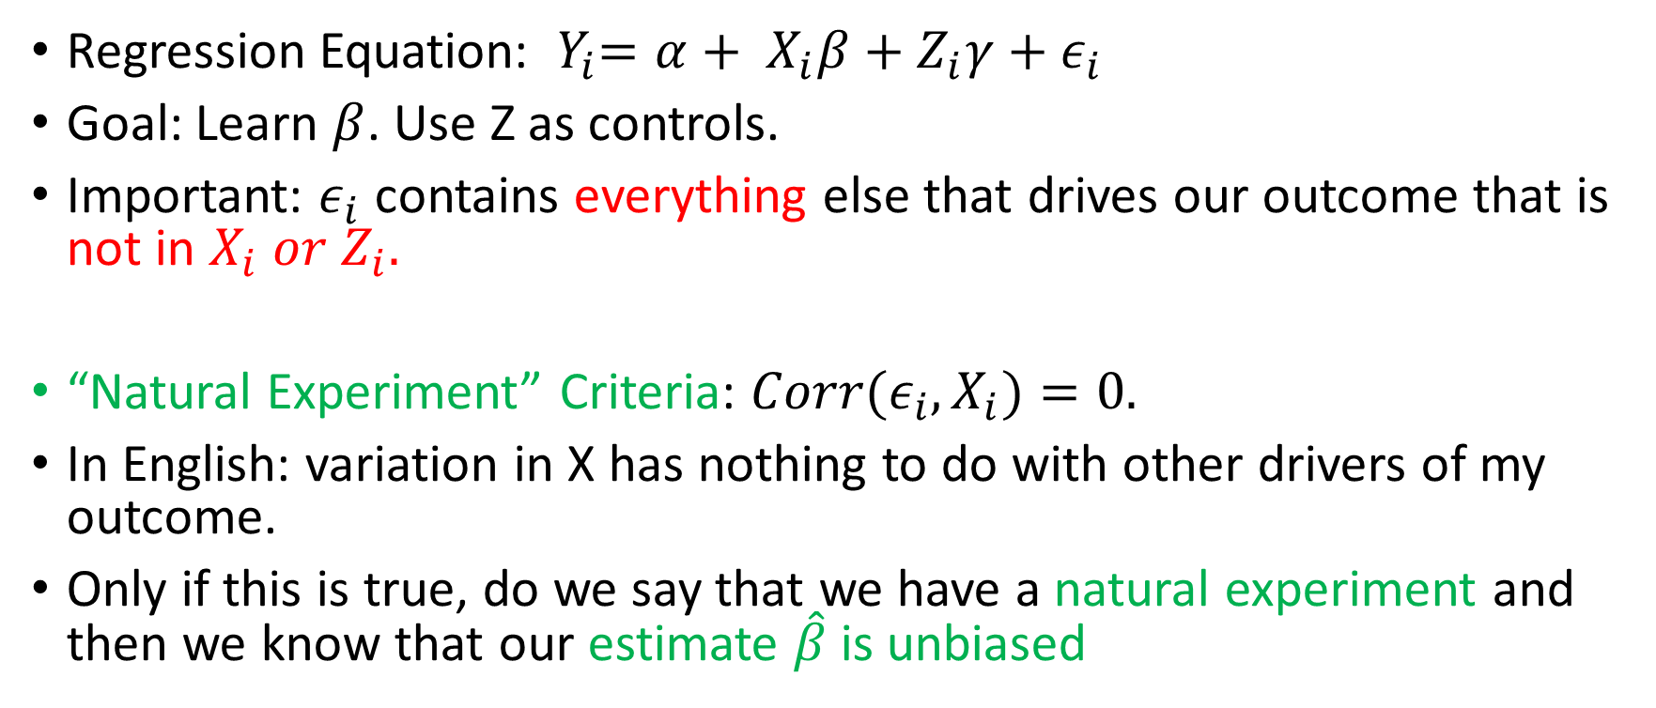
The “Natural Experiment” Criteria
Regression Equation: ${ Y}_{i}=α+ X_{i}β+Z_{i}γ+ε_{i}$
Goal: Learn $β$. Use Z as controls.
Important: $ε_{i}$ contains everything else that drives our outcome that is not in $X_{i} or Z_{i}.$
“Natural Experiment” Criteria: ${Corr(ε}_{i},X_{i})=0.$
In English: variation in X has nothing to do with other drivers of my outcome.
Only if this is true, do we say that we have a natural experiment and then we know that our estimate $\hat{β}$ is unbiased

Slide 12
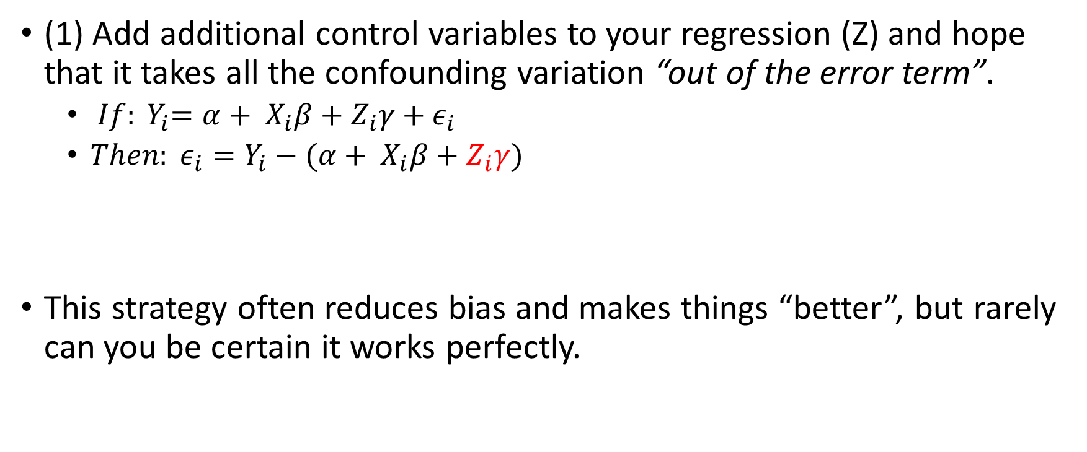
Getting Closer to a Natural Experiment with Controls
(1) Add additional control variables to your regression (Z) and hope that it takes all the confounding variation “out of the error term”.
${ If: Y}_{i}=α+ X_{i}β+Z_{i}γ+ε_{i}$
${{Then: ε}_{i}=Y}_{i}−(α+ X_{i}β+Z_{i}γ)$
This strategy often reduces bias and makes things “better”, but rarely can you be certain it works perfectly.

Slide 13
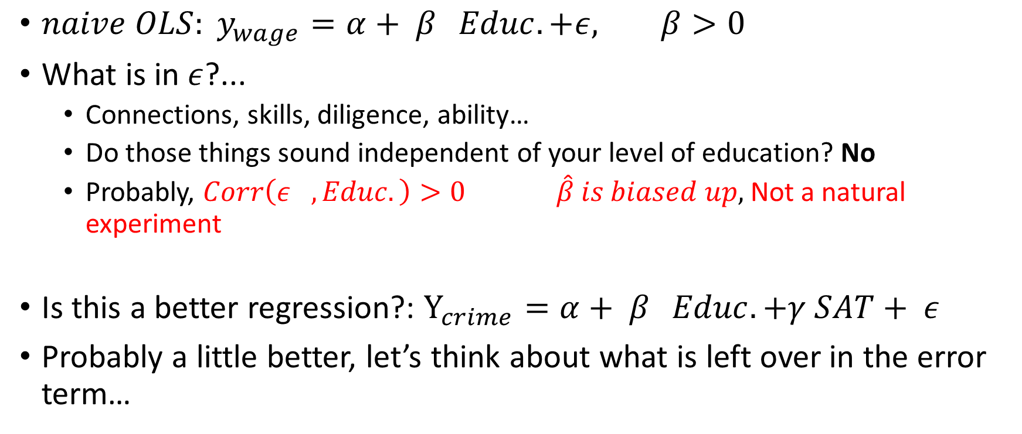
For Example (Returns to Education)….
${naive OLS: y}_{wage}=α+ β_{}Educ.+ε, β>0$
What is in $ε$?...
Connections, skills, diligence, ability…
Do those things sound independent of your level of education? No
Probably, $Corr\left(ε_{}, Educ.\right)>0 \hat{β} is biased up,$Not a natural experiment
Is this a better regression?: $Y_{crime}=α+ β_{}Educ.+γ SAT+ ε$
Probably a little better, let’s think about what is left over in the error term…

Slide 14
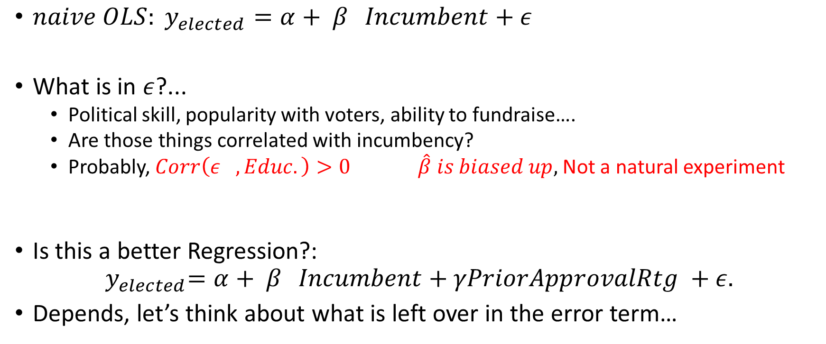
For Example (Incumbency)….
${naive OLS: y}_{elected}=α+ β_{}Incumbent+ε$
What is in $ε$?...
Political skill, popularity with voters, ability to fundraise….
Are those things correlated with incumbency?
Probably, $Corr\left(ε_{}, Educ.\right)>0 \hat{β} is biased up,$Not a natural experiment
Is this a better Regression?:
$${ y}_{elected}=α+ β_{}Incumbent+γPriorApprovalRtg +ε.$$
Depends, let’s think about what is left over in the error term…

Slide 15
Research Design: Difference in Differences (DiD)

Slide 16
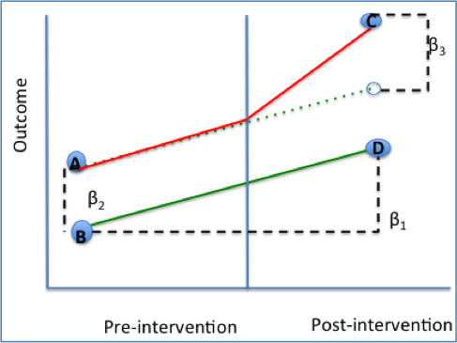
Difference in Differences
Common strategy for exploiting sudden policy changes.
Basic idea:
Focus analysis only on a treatment group that was exposed to a policy change and a control group that was not.
Compare the pre-post trend for these two groups. Attribute any difference in trends to the impact of the treatment.
Key Assumption: “Parallel trends”

Slide 17
3 ways to looks at DD
In a Box
Graphically
In a Regression

Slide 18
Graphically
Not enrolled
Y₁ | G_{i}=0
Outcome Variable
Y₀ | G_{i}=0
Y₁ | G_{i}=1
Enrolled
Estimated Treatment Effect
Y₀ | G_{i}=1
Only data point to get intervention
T=0
T=1
Time

Slide 19
The box
Only cell to get intervention
 | Group affected by the policy change (treatment group) | Group that is not affected by the policy change (control group)
After the program start | Y₁ | G_{i}=1 | Y₁ | G_{i}=0
Before the program start | Y ₀ | G_{i}=1 | Y₀ | G_{i}=0
“Diff” | (Y₁|G=1)-(Y₀|G=1) | (Y₁|G=0)-(Y₀|G=0)
“Diff in Diffs”:
DD=[(Y₁|G=1)-(Y₀|G=1)] - [(Y₁|G=0)-(Y₀|G=0)]

Slide 20
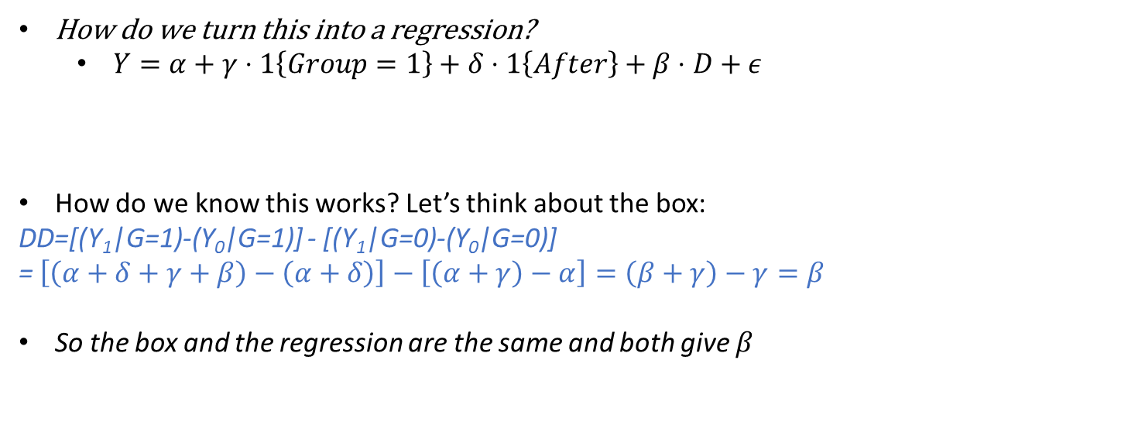
Regression
How do we turn this into a regression?
$Y=α+γ⋅1\left\{Group=1\right\}+δ⋅1\left\{After\right\}+β⋅D+ε$
How do we know this works? Let’s think about the box:
DD=[(Y₁|G=1)-(Y₀|G=1)] - [(Y₁|G=0)-(Y₀|G=0)]
= $\left[\left(α+δ+γ+β\right)−\left(α+δ\right)\right]−\left[\left(α+γ\right)−α\right]=\left(β+γ\right)−γ=β$
So the box and the regression are the same and both give $β$

Slide 21
Should we Believe DiD designs?
Only if we believe in the “parallel trends” assumption. That is: Any difference in the “natural trend” of our two groups shows up in our error term and is certainly correlated with treatment.
Graphically: We should only believe DiD if we thought the red and the green lines would have had the same slope in the absence of the intervention.
$$Y=α+γ⋅1\left\{Group=1\right\}+δ⋅1\left\{After\right\}+β⋅D+ε$$

Slide 22
Research Design: Regression Discontinuity

Slide 23
Discontinuity
An arbitrary change in treatment assignment that happens at a specific threshold.
We’re interested in the ones that make very similar people get very dissimilar treatment.

Slide 24
Discontinuity Examples: Incumbency Advantage
U.S. House Elections
If you’re first past the pole in the previous election, even by just one vote, you get elected
What can we learn from this?
Incumbency advantage for reelection.
(David Lee, Journal of Econometrics 2007)

Slide 25
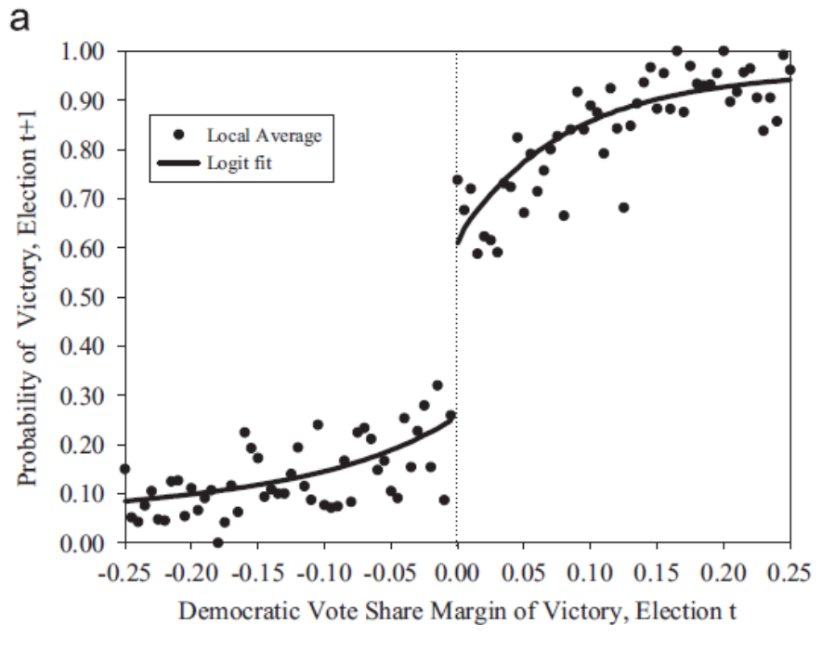
Discontinuity Examples: Incumbency Advantage
Question: All else equal, does winning one political election help you win the next election? (Incumbency effect)
Bad Answer (OLS): Compare the average performance of winners and losers.
Problem: Winning the first election is not random. Is likely to be correlated with characteristics of local electorate. In this case, estimate of effect is biased up.

Slide 26
Regression Discontinuity (RD)
Question: All else equal, does winning one political election help you win the next election? (Incumbency effect)
Best Solution: Compare elections where the Democrats get ~49.9% of vote to elections where they get ~50.1%.
NOTE: This approach is only possible because treatment (winning the first election) is assigned based on a threshold.
Polynomial trends on each side of discontinuity mitigate bias.

Slide 27
Discontinuity Examples: PSAT
PSAT/NMSQT
Basically the top 16,000 test-takers get a scholarship.
A small difference in test score can means a discontinuous jump in scholarship amount.
What can we learn from this?
Wage returns to scholarships/education
Notes:
Supposed to be by Thistlewaite, but I can’t find the reference

Slide 28
Discontinuity Examples: Class Size
School Class Size
Maimonides’ Rule--No more than 40 kids in a class in Israel.
40 kids in school means 40 kids per class. 41 kids means two classes with 20 and 21.
What can we learn from this?
Impact of class size on test scores/performance
(Angrist & Lavy, QJE 1999)

Slide 29
Discontinuity Examples: Impact of Unionization
Union Elections
If employers want to unionize, NLRB holds election. 50% means the employer doesn’t have to recognize the union, and 50% + 1 means the employer is required to “bargain in good faith” with the union.
What can we learn from this?
Impact of unionization on wages/employment/firm closure…
(DiNardo & Lee, QJE 2004)

Slide 30
A Bandwidth of Randomness
Election outcomes aren’t random so incumbency is never randomly assigned
But is a district that voted 50.1% for a democrat that different from one that voted 49.9% for a democrat?
Probably not. Right around the cutoff, there’s a good chance things are random.
However, picking the right cutoff is difficult. You should try to pick it so that you a “convincing picture”.

Slide 31
Implementing a Regression Discontinuity
Select a subset of data around the discontinuity (c). I.E. |X-c|<h for some “reasonable value of h”.
Regressors:
1: Constant
(x>c): Treatment
1{x>c}*(x-c): linear trend above treatment
1{x<c}*(x-c): linear trend below treatment
Can also include (if it improves fit):
1{x>c}*(x-c)^2, 1{x>c}*(x-c)^3: cubic trend above treatment
1{x<c}*(x-c)^2, 1{x<c}*(x-c)^3 : cubic trend below treatment

